Slide 1
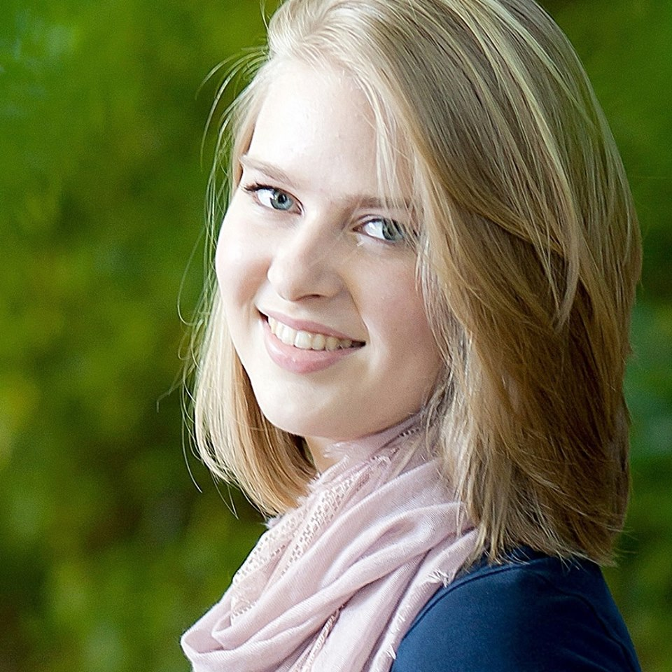
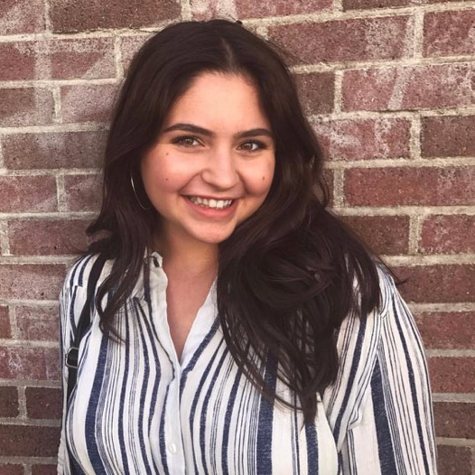
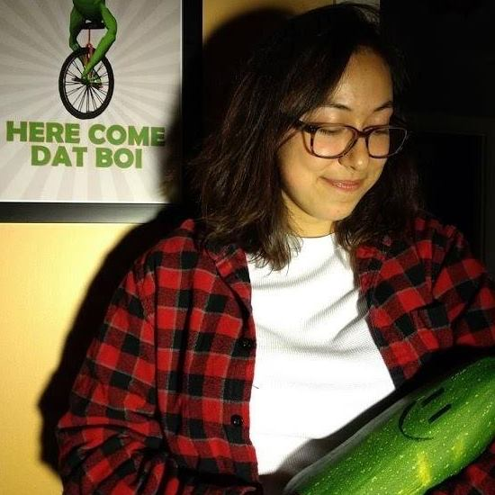
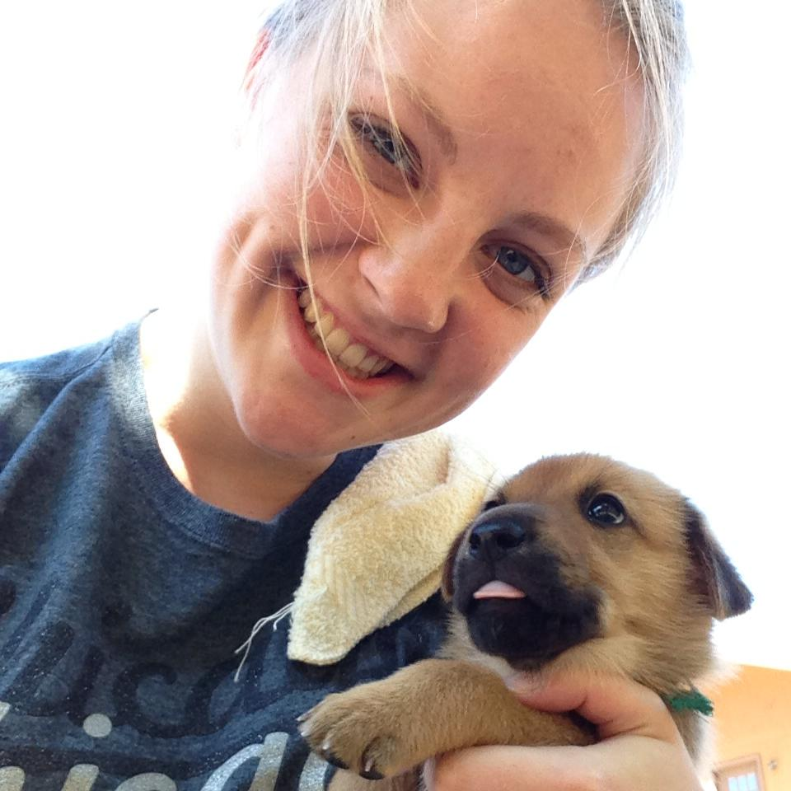
Cake Catalog
i
Meet your Cake Consultants!
Cake
Catalog
Amanda Crawford
Talia Moretty
Amanda Dattalo
Carly Stasack
Favorite Cake:
Favorite Cake:
Yellow cake with chocolate frosting
Favorite Cake:
Favorite Cake:

